Slide 1
Time Series
September 2019
Time flies over us, but leaves its shadow behind.
- Nathaniel Hawthorne

Slide 2
Contents for today
Time Series
Visualization
Models
Evaluation
Exp. Smooth / State Space
ARIMA

Slide 3



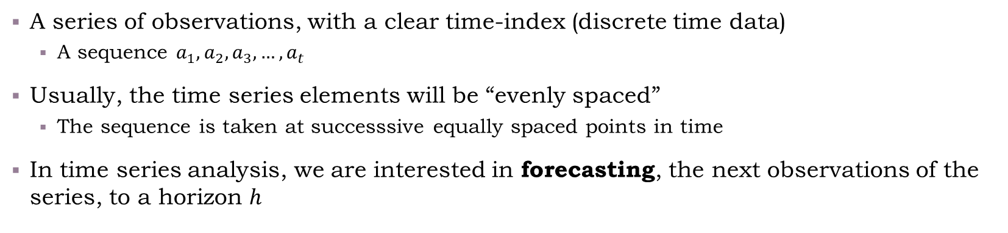





What is a Time Series?
A series of observations, with a clear time-index (discrete time data)
A sequence $a_{1},a_{2},a_{3},…,a_{t}$
Usually, the time series elements will be “evenly spaced”
The sequence is taken at successsive equally spaced points in time
In time series analysis, we are interested in forecasting, the next observations of the series, to a horizon $h$
Demand/#Events/
Precipitation/Stock prices/…
$$a_{1}$$
$$a_{2}$$
$$a_{3}$$
$$a_{4}$$
$$a_{t}$$
$$a_{t+1}$$
$$a_{t+h}$$
…
…
Hour/Day/ Month/Quarter/…
1
2
3
4
$$t$$
existing observations
forecast

Slide 4
Forecasting Time Series
A time series can be defined on a lot of things, but not any times series can be forecasted
Predictability of an event or quantity can depend on
Understanding of contributing factors
Availability of data
Do forecasts influence future measurements

Slide 5
Forecasting Time Series – Examples
Electricity demand
Influenced by temperature, calendar (holidays, weekdays/weekends, economy)
Can be predicted reliably
Demand of retail products
Influenced by season/weekday
Influenced by previous forecasts (if we go “out-of-stock” we will measure “0 demand”)
Stock prices
Very hard to predict – it’s basically a Brownian motion (random)
Forecasts for stock prices affect the stock prices

Slide 6
Short-Medium-Long Term
When forecasting we are trying to predict the future in the most accurate way
Forecasts are provided as a baseline for planning
Roughly speaking, we can split the type of forecasts to:
Short-term: operational decisions
What’s going to happen in the next seconds/…/days ahead
Examples: bid on FOREX, electricity generation, personnel scheduling, etc.
Medium-term: resource planning
What’s going to happen in the next days/months/quarters
Examples: importing goods, hiring personnel
Long-term: strategic planning
What’s going to happen in the next quarters/years/decades
Examples: Building a new power plant, entering a new market
In production
“Offline” research

Slide 7
Forecast Workflow
Problem Definition
Information Gathering
Visualizations, Business Cycles, Seasonality, Outliers,
Variable relationships
Exploratory Analysis
Baseline models, Exponential Smoothing, ARIMA, Hierarchical, etc.
Model Fitting
Model Evaluation
MAPE, MASE, RMSE, etc.
Train/Test

Slide 8
Exploratory Analysis of Time Series
The class for time series is a `tsibble` (a time series-tibble) from the package bearing that name
In base R there is a class called ts
Time series objects
class code/06-time_series.R

Slide 9
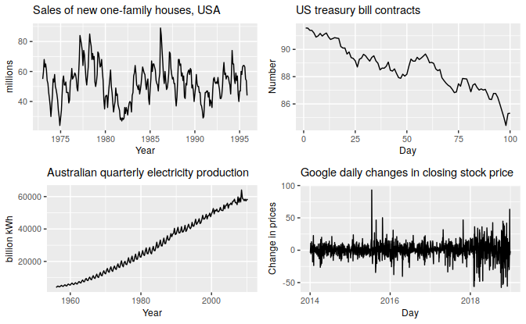
Time Plots and Patterns
The “basic” plot we deal with, simply shows the series as a function of time
We can use it to identify patterns in the series.
Trend – Long term increase or decrease in the data.
Seasonal – The series is affected by “seasonal” factors: time of year, time of day, day of the week, day of month, etc. Fixed and known frequency.
Cyclic – “Rise and falls” but without a fixed frequency.
We need to identify the patterns before choosing a proper model for the series.

Slide 10

Exercise: Identify the Patterns
Can you identify which patterns appear in each figure?
Reference: Forecasting: Principles and Practice, Rob J Hyndman and George Athanasopoulos,
https://otexts.com/fpp3/, chapter 2.3.

Slide 11
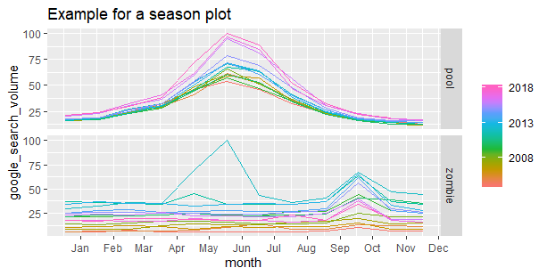
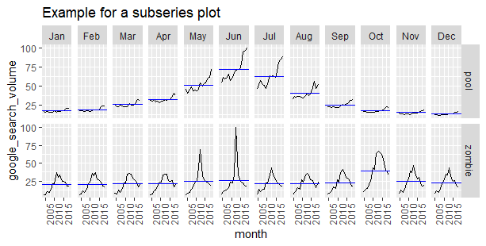
Plots for Identifying Seasonality

Slide 12
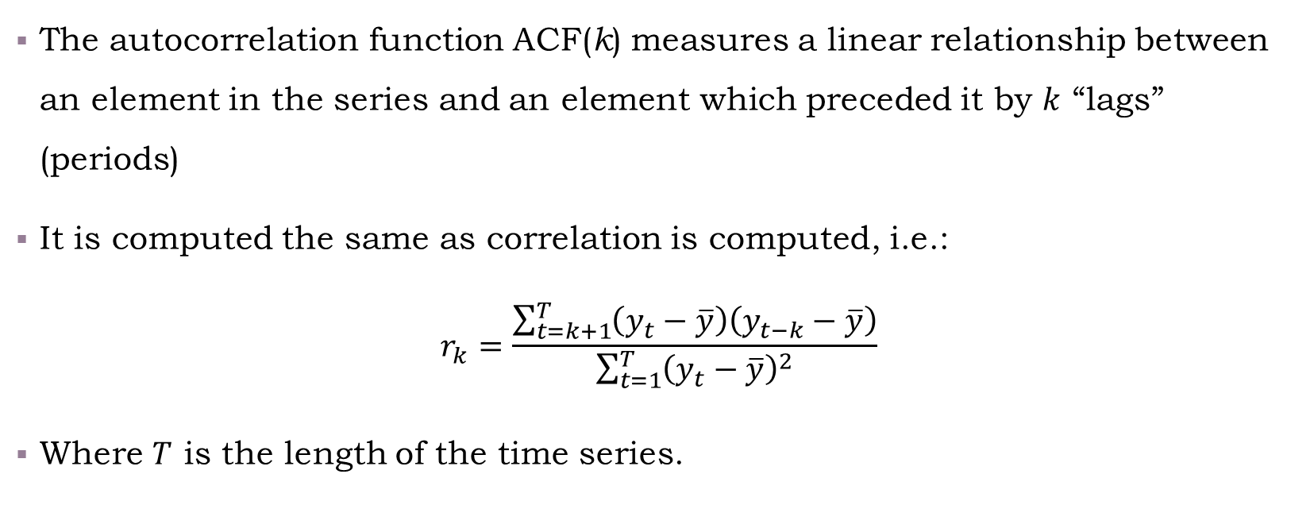
Autocorrelation Function (ACF)
The autocorrelation function ACF(k) measures a linear relationship between an element in the series and an element which preceded it by $k$ “lags” (periods)
It is computed the same as correlation is computed, i.e.:
$$r_{k}=\frac{\sum_{t=k+1}^{T}{\left(y_{t}−\overline{y}\right)\left(y_{t−k}−\overline{y}\right)}}{\sum_{t=1}^{T}{{\left(y_{t}−\overline{y}\right)}^{2}}}$$
Where $T$ is the length of the time series.

Slide 13
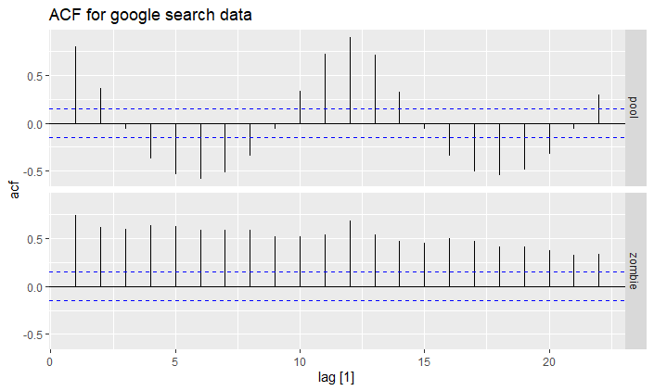
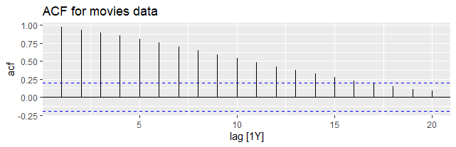
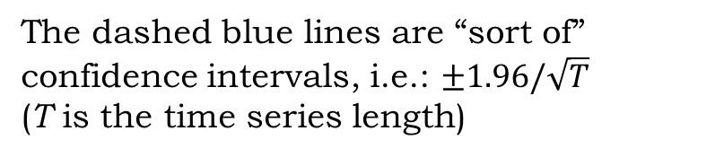
ACF Visualization
The ACF shows which seasonal patterns and additional dependencies emerge from the series
Indicates seasonality
(small “spaced” spikes)
Indicates a trend
(close lags w/ high dependency)
The dashed blue lines are “sort of” confidence intervals, i.e.: $±1.96/\sqrt{T}$
(T is the time series length)
Notes:
There is also a “partial autocorrelation function”, the equivalent of “partial correlation”.
The partial autocorrelation function shows the autocorrelation of the residuals of $a_{i}$ regressed against $a_{i−k},…,a_{i−1}$ correlated with the residuals of $a_{i−1}$ regressed against $a_{i−k−1},…,a_{i−2}$. This is related to autoregressive (ARIMA) models, which we will discuss later.

Slide 14
Back to coding
Examples for the figures
/class code/06-time_series.R

Slide 15
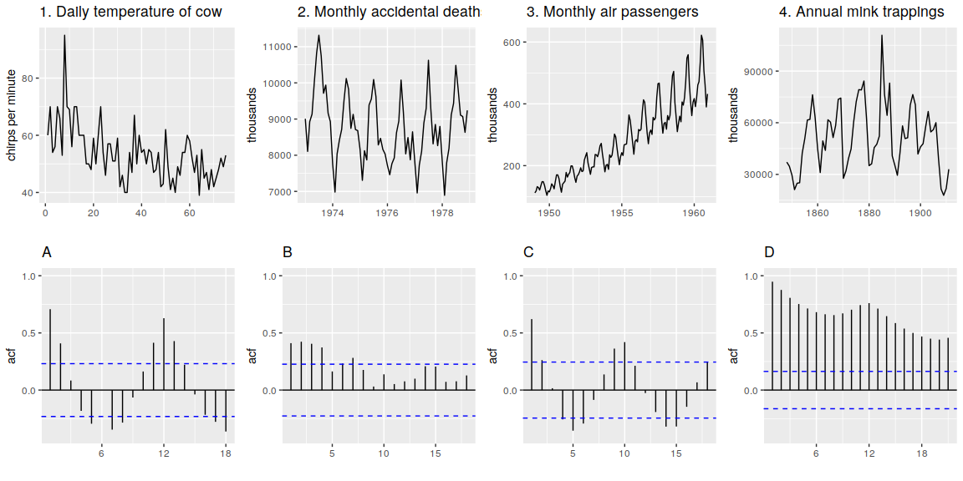
Time Series ACF Exercise Take 5 minutes in pairs – match the series to the ACF
Source: https://otexts.com/fpp3/graphics-exercises.html
Exercise 7.
Notes:
Answers:
1 -> B is the easiest to match because it clearly has no “seasonality” patterns
3 -> D very strong seasonality + trend. Classic.
2 -> A Clearly shows a 12-month seasonality, and very consistent about it
4 -> C The peaks keep moving so it’s not a strong seasonality. The ACF shows a corrlation at lag=10

Slide 16
Forecast Workflow
Problem Definition
Information Gathering
Visualizations, Business Cycles, Seasonality, Outliers,
Variable relationships
Exploratory Analysis
Baseline models, Exponential Smoothing, ARIMA, Hierarchical, etc.
Model Fitting
Model Evaluation
MAPE, MASE, RMSE, etc.
Train/Test

Slide 17
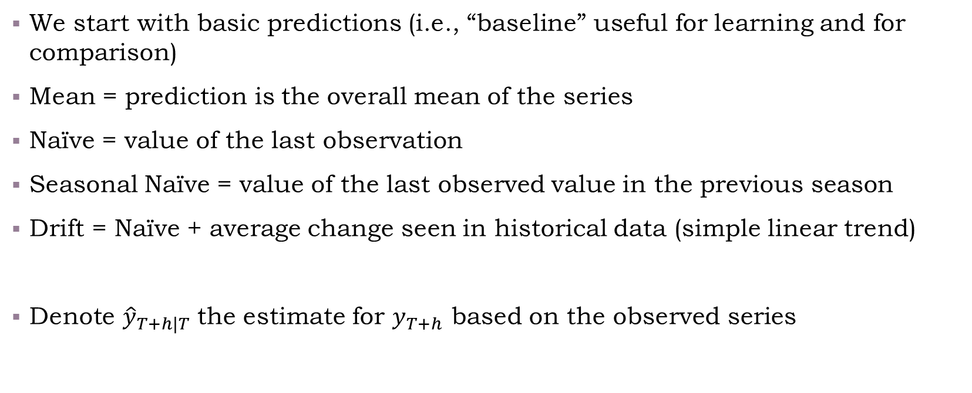
Kickoff: Benchmark methods
We start with basic predictions (i.e., “baseline” useful for learning and for comparison)
Mean = prediction is the overall mean of the series
Naïve = value of the last observation
Seasonal Naïve = value of the last observed value in the previous season
Drift = Naïve + average change seen in historical data (simple linear trend)
Denote ${\hat{y}}_{T+h|T}$ the estimate for $y_{T+h}$ based on the observed series

Slide 18
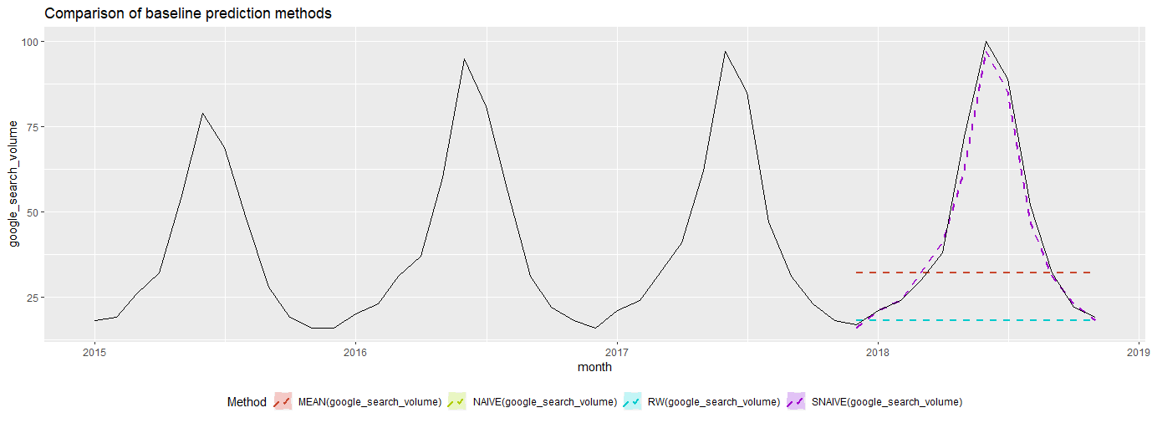
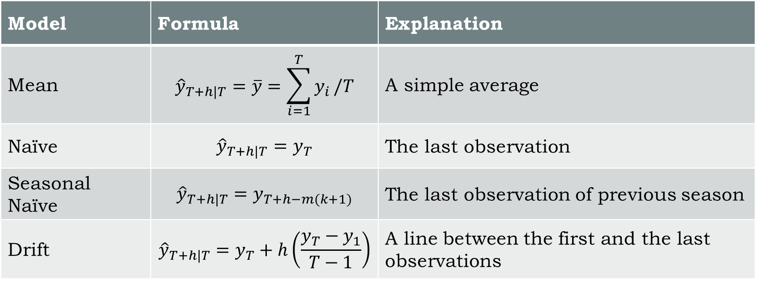
Benchmark methods Explained
Model | Formula | Explanation
Mean | $${\hat{y}}_{T+h|T}=\overline{y}=\sum_{i=1}^{T}{y_{i}}/T$$ | A simple average
Naïve | $${\hat{y}}_{T+h|T}=y_{T}$$ | The last observation
Seasonal Naïve | $${\hat{y}}_{T+h|T}=y_{T+h−m(k+1)}$$ | The last observation of previous season
Drift | $${\hat{y}}_{T+h|T}=y_{T}+h\left(\frac{y_{T}−y_{1}}{T−1}\right)$$ | A line between the first and the last observations
Show basic predictions via /class code/06-time_series.R

Slide 19
Forecast Workflow
Problem Definition
Information Gathering
Visualizations, Business Cycles, Seasonality, Outliers,
Variable relationships
Exploratory Analysis
Baseline models, Exponential Smoothing, ARIMA, Hierarchical, etc.
Model Fitting
Model Evaluation
MAPE, MASE, RMSE, etc.
Train/Test

Slide 20
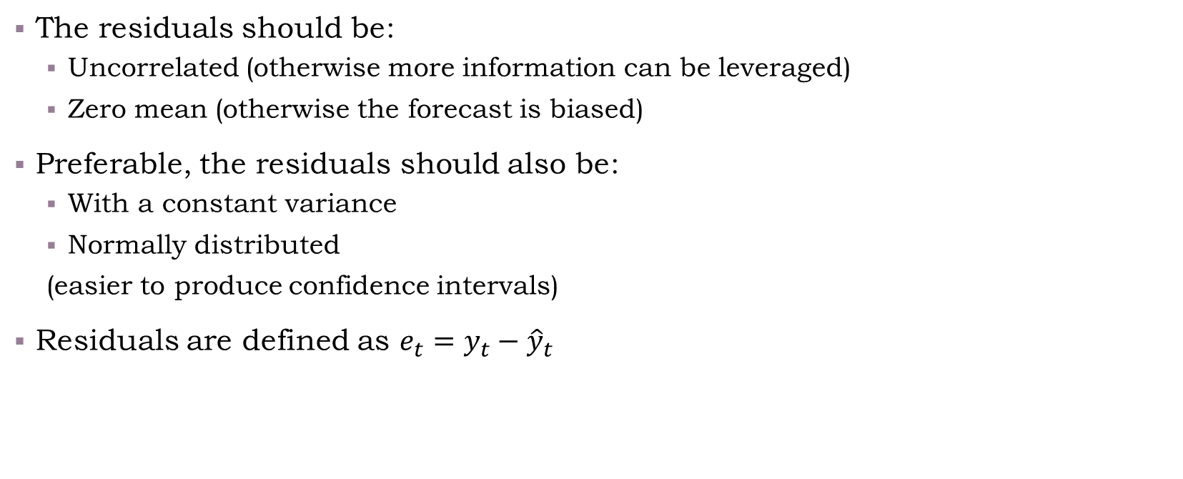
Model Evaluation: Residuals
The residuals should be:
Uncorrelated (otherwise more information can be leveraged)
Zero mean (otherwise the forecast is biased)
Preferable, the residuals should also be:
With a constant variance
Normally distributed
(easier to produce confidence intervals)
Residuals are defined as $e_{t}=y_{t}−{\hat{y}}_{t}$

Slide 21
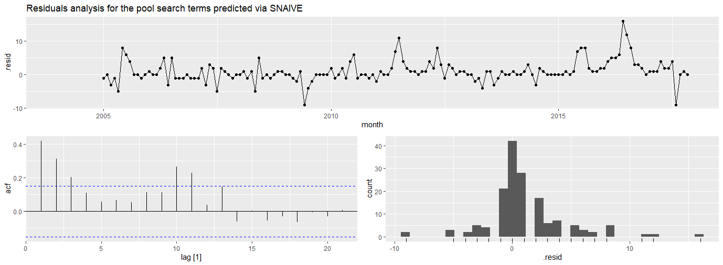
Analyzing Residuals gg_tsresiduals Can you identify problems with SNAIVE’s forecast?
Notes:
The ACF (bottom left) shows that the SNAIVE did not capture the dependence between an observation and the one which came before it.
The histogram (bottom right) shows that the distribution of residuals is heavy right-tailed and spread, it does not look normally distributed.
The time plot (upper plot) does not look biased or with a certain trend for the most part.

Slide 22
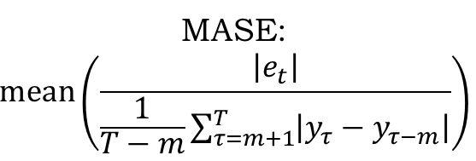
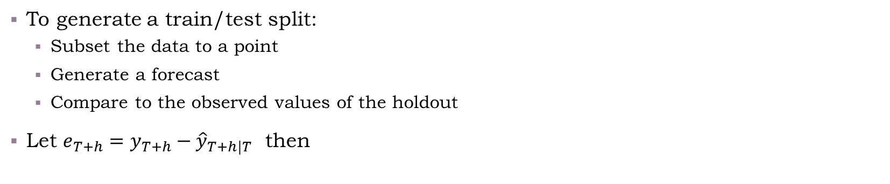




Measuring Test Set Errors
To generate a train/test split:
Subset the data to a point
Generate a forecast
Compare to the observed values of the holdout
Let $e_{T+h}=y_{T+h}−{\hat{y}}_{T+h|T}$ then
Scale Dependent Errors
Percentage Errors
Scaled Errors
(on train set)
MAE: $\text{mean}(|e_{t}|)$
MAPE: $\text{mean}(|e_{t}/y_{t}|)$
MASE:
$$\text{mean}\left(\frac{\left|e_{t}\right|}{\frac{1}{T−m}\sum_{τ=m+1}^{T}{\left|y_{τ}−y_{τ−m}\right|}}\right)$$
RMSE: $\sqrt{\text{mean}(e_{t}^{2})}$
sMAPE: $\text{mean}(2|e_{t}/(y_{t}+{\hat{y}}_{t})|)$
Notes:
Scale dependent:
Minimizing RMSE will lead to results close to the mean.
The MAE will lead to results close to the median (and is slightly better interpretable than the RMSE).
(Reminds you of linear regression, based on $L_{2}$ versus quantile regression based on $L_{1}$, doesn’t it?)
Percentage:
The MAPE is very interpretable, but, has a problem when $y_{t}=0$, and can have extreme values for very low $y_{t}$’s
The sMAPE (symmetric-MAPE) solves the problem of division by 0, but when both prediction and observed values are close to 0, the measure still explodes.
Scaled:
The mean absolute scaled error compares the performance of the forecast versus a naïve model (or seasonal naïve model if seasonality is examined). If the MASE is greater than 1 than the naïve model is better.

Slide 23
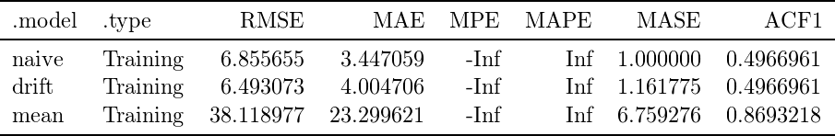
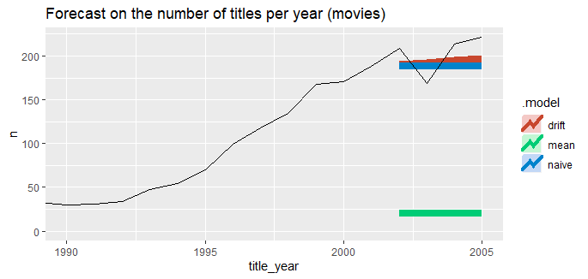
Exercise – In pairs Determine which measures are reported in each column
A
B
C
D
Choose from:
Mean percentage error (MPE)
Mean absolute percentage error (MAPE)
Mean absolute scaled error (MASE)
Root mean squared error (RMSE)

Slide 24
Live Coding – Computing Accuracy
See implementation in class code/06-time_series.R

Slide 25
Forecast Workflow
Problem Definition
Information Gathering
Visualizations, Business Cycles, Seasonality, Outliers,
Variable relationships
Exploratory Analysis
Baseline models, Exponential Smoothing, ARIMA, Hierarchical, etc.
Model Fitting
Model Evaluation
MAPE, MASE, RMSE, etc.
Train/Test

Slide 26
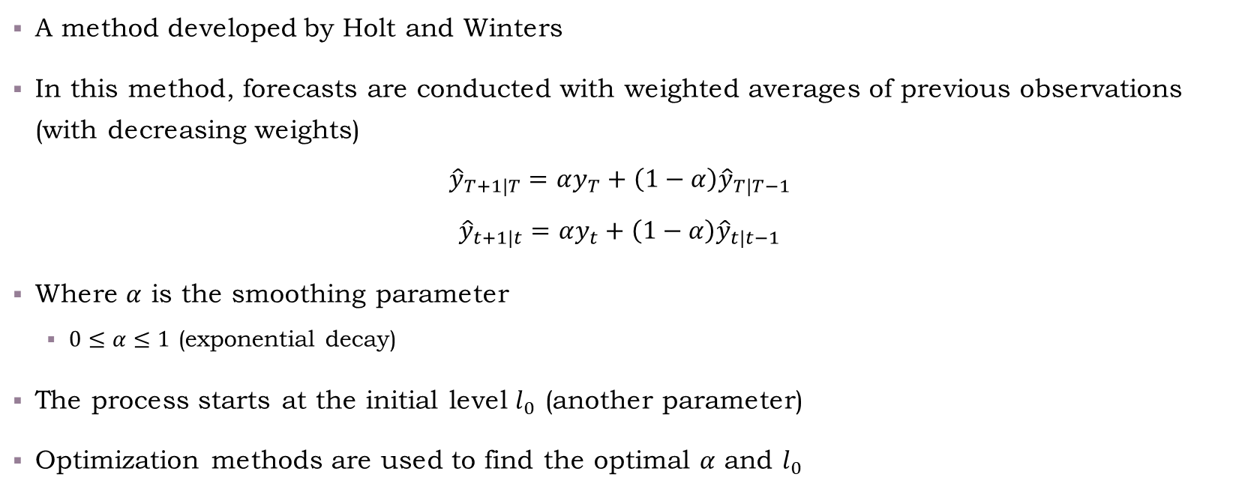
Simple Exponential Smoothing
A method developed by Holt and Winters
In this method, forecasts are conducted with weighted averages of previous observations (with decreasing weights)
$${\hat{y}}_{T+1|T}=αy_{T}+\left(1−α\right){\hat{y}}_{T|T−1}$$
$${\hat{y}}_{t+1|t}=αy_{t}+\left(1−α\right){\hat{y}}_{t|t−1}$$
Where $α$ is the smoothing parameter
$0≤α≤1$ (exponential decay)
The process starts at the initial level $l_{0}$ (another parameter)
Optimization methods are used to find the optimal $α$ and $l_{0}$

Slide 27
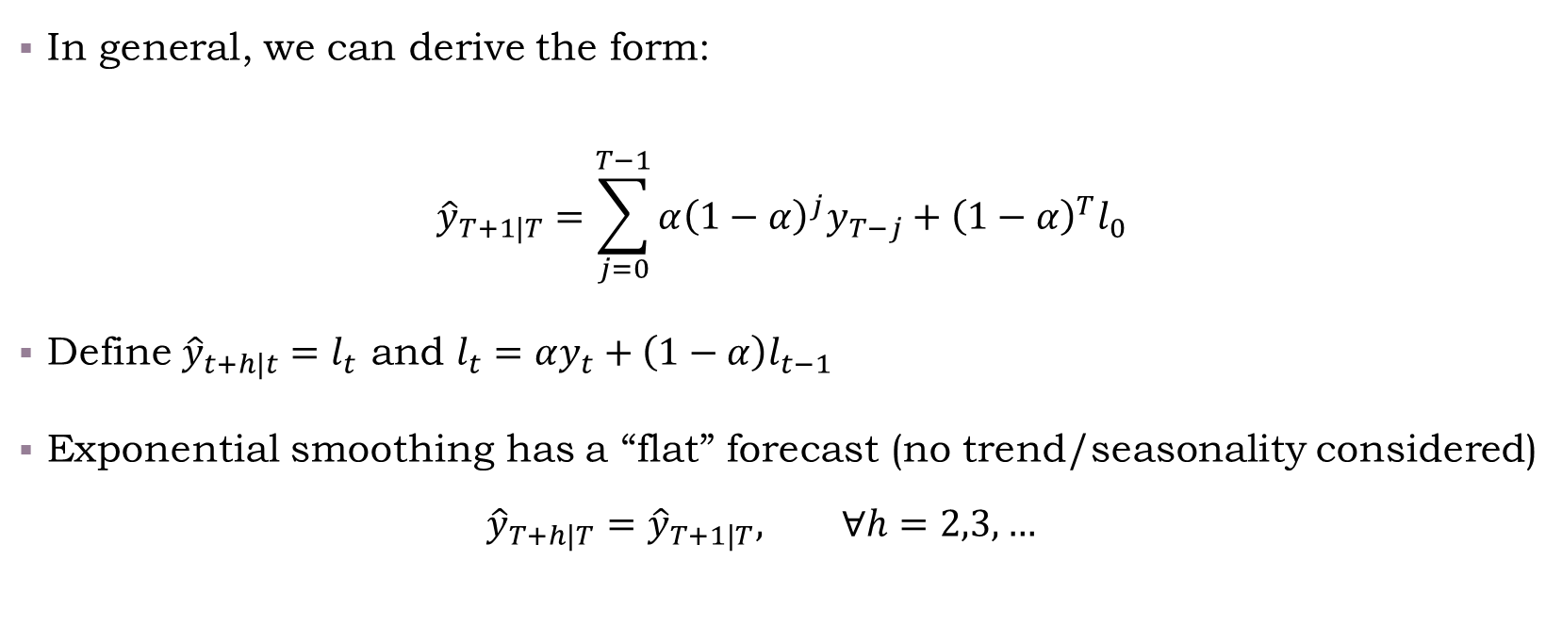
Simple Exponential Smoothing
In general, we can derive the form:
$${\hat{y}}_{T+1|T}=\sum_{j=0}^{T−1}{α{\left(1−α\right)}^{j}y_{T−j}}+{\left(1−α\right)}^{T}l_{0}$$
Define ${\hat{y}}_{t+h|t}=l_{t}$ and $l_{t}=αy_{t}+\left(1−α\right)l_{t−1}$
Exponential smoothing has a “flat” forecast (no trend/seasonality considered)
$${\hat{y}}_{T+h|T}={\hat{y}}_{T+1|T}, ∀h=2,3,…$$

Slide 28
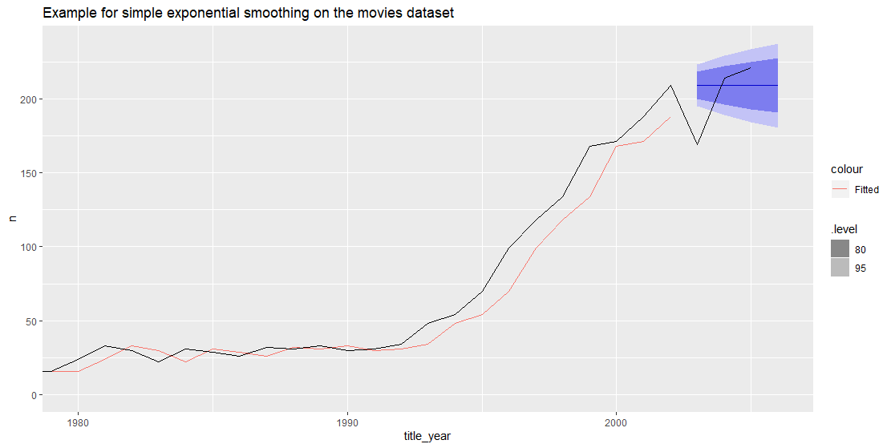
Simple Exponential Smoothing – Illustration
This is how exponential smoothing would look like on the movies data
Forecast is “flat”
Fitted values “lag” behind

Slide 29
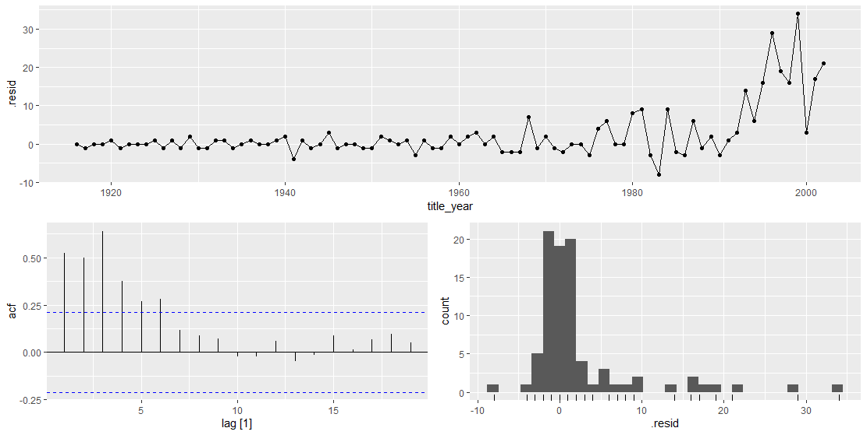
Examine Residuals for More Insights
What can we learn from examining the former model’s residuals?
Notes:
We were not able to capture an apparent trend in the data; and
There still seems to be a high autocorrelation at low lags (k<5)

Slide 30
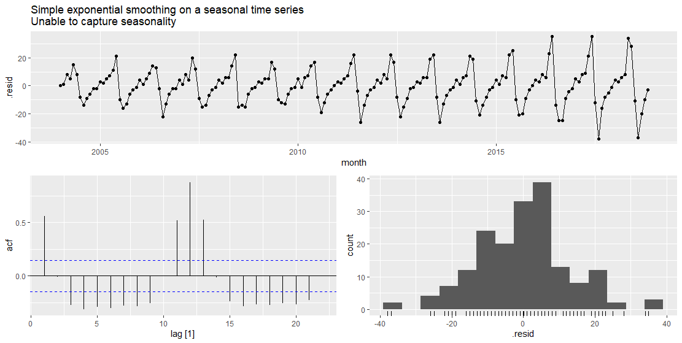
See Demonstration
class code/06-time_series.R
Cannot capture seasonality with SES

Slide 31
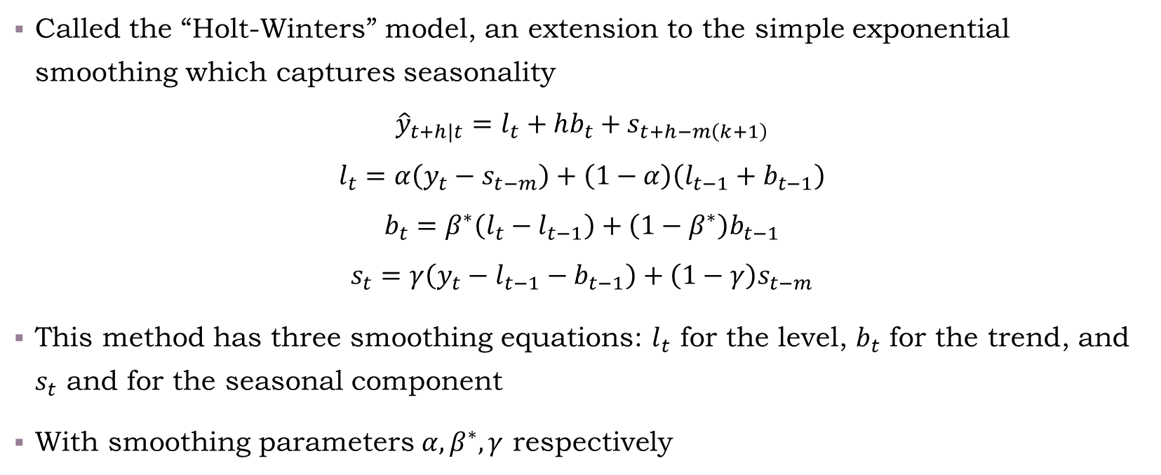
Extension for Seasonality and Trend
Called the “Holt-Winters” model, an extension to the simple exponential smoothing which captures seasonality
$${\hat{y}}_{t+h|t}=l_{t}+hb_{t}+s_{t+h−m\left(k+1\right)}$$
$$l_{t}=α\left(y_{t}−s_{t−m}\right)+\left(1−α\right)\left(l_{t−1}+b_{t−1}\right)$$
$$b_{t}=β^{∗}\left(l_{t}−l_{t−1}\right)+\left(1−β^{∗}\right)b_{t−1}$$
$$s_{t}=γ\left(y_{t}−l_{t−1}−b_{t−1}\right)+\left(1−γ\right)s_{t−m}$$
This method has three smoothing equations: $l_{t}$ for the level, $b_{t}$ for the trend, and $s_{t}$ and for the seasonal component
With smoothing parameters $α,β^{∗},γ$ respectively
Notes:
In the multiplicative models we just multiply instead of add:
$${\hat{y}}_{t+h|t}=(l_{t}+hb_{t})s_{t+h−m\left(k+1\right)}$$
$$l_{t}=α\left(y_{t}/s_{t−m}\right)+\left(1−α\right)\left(l_{t−1}+b_{t−1}\right)$$
$$b_{t}=β^{∗}\left(l_{t}−l_{t−1}\right)+\left(1−β^{∗}\right)b_{t−1}$$
$$s_{t}=γ\left(\frac{y_{t}}{l_{t−1}−b_{t−1}}\right)+\left(1−γ\right)s_{t−m}$$

Slide 32
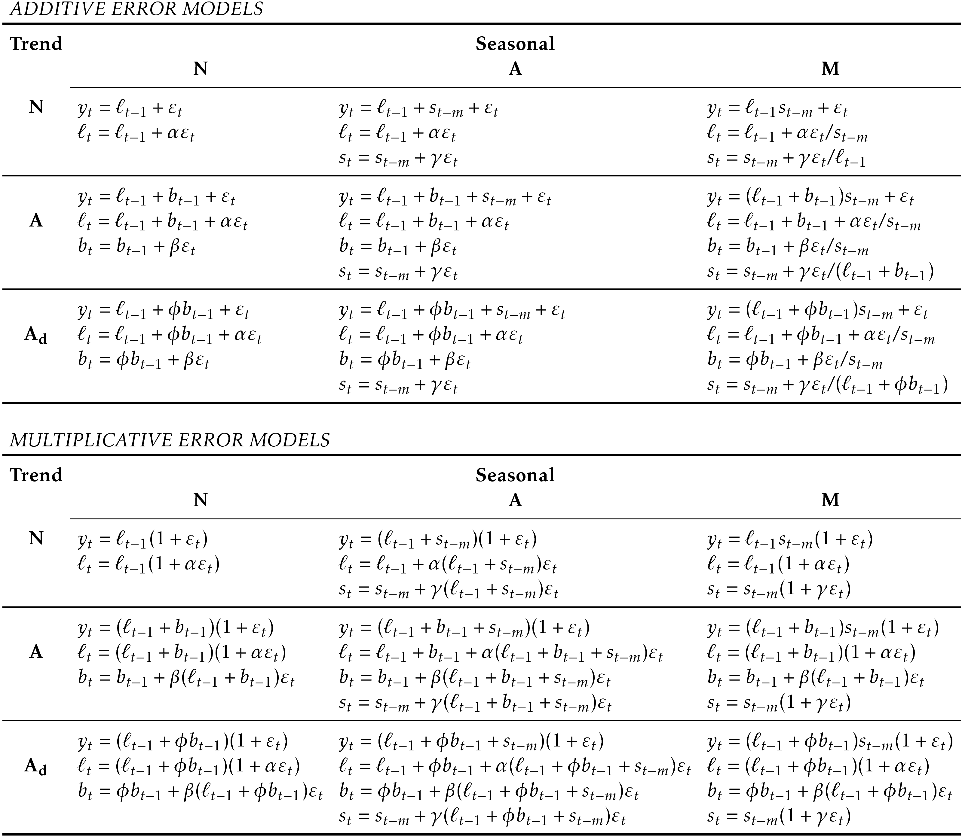
Innovations State Space Models
By playing with the difference combinations of season/trend/additive-multiplicative we can generate a family of 18 different models
The share the name ETS
(Error-Trend-Season)
A framework for selecting models from this family is provided by the ETS function
Optimization criteria determined by argument opt_crit

Slide 33
Forecast Workflow
Problem Definition
Information Gathering
Visualizations, Business Cycles, Seasonality, Outliers,
Variable relationships
Exploratory Analysis
Baseline models, Exponential Smoothing, ARIMA, Hierarchical, etc.
Model Fitting
Model Evaluation
MAPE, MASE, RMSE, etc.
Train/Test

Slide 34
References
https://otexts.com/fpp3/
https://tidyverts.org/

